Slide 1

STiK VS STICK

Slide 2
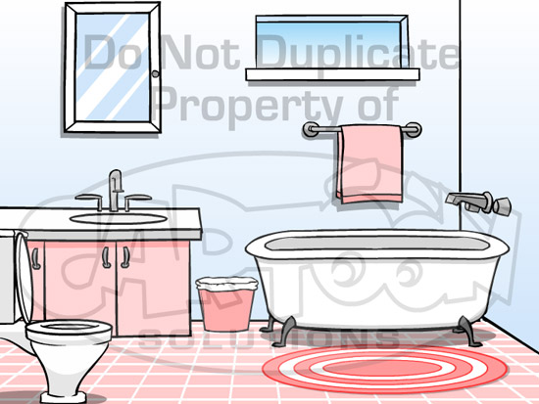

Slide 3

*Flush*

Slide 4

…

Slide 5
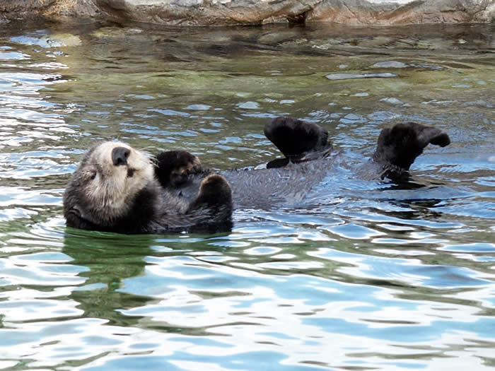

Slide 6

!!

Slide 7

!!!

Slide 8
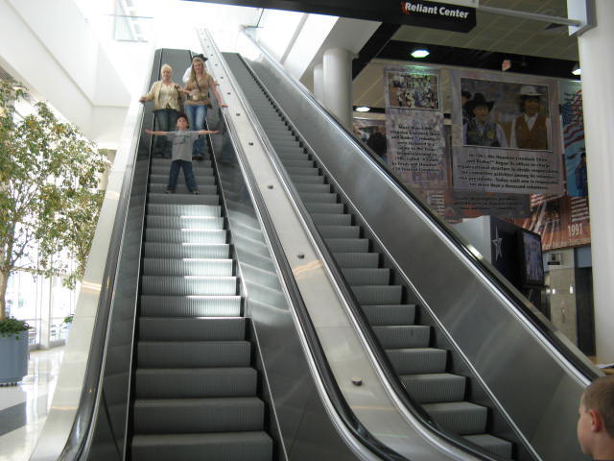

Slide 9

!!

Slide 11


Slide 12


Slide 13
The End!
Mortal Combat:
Stick vs Stik
!!

